Slide 1
Computer Vision
Part 1: Feature Learning
ADF – Start 08:30

Slide 2

Agenda
Part 1: Feature Learning
AutoEncoder
Transfer Learning
Part 2: Deep Learning Architectures
Famous Architectures
ImageNet Winner 2012-2017
Computer Vision

Slide 3
Auto Encoder
Computer Vision

Slide 4
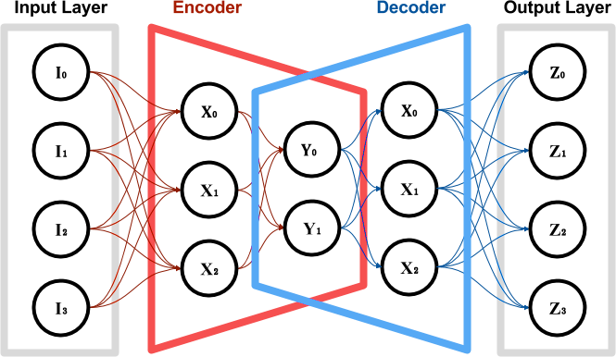
Auto Encoder
Consists of 2 Network side-by-side called Encoder and Decoder
Reproduce the input via learning features
Computer Vision

Slide 5
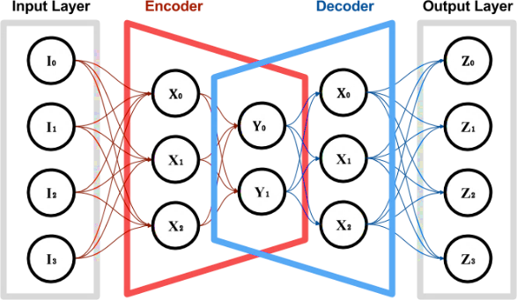
Auto Encoder: Parts
Encoder network accepts inputs and try to reduce it into a smaller dimension (latent space)
Decoder network receives reduced dimension from Encoder and tries to restore it to its original dimension
Called Auto-associative Network:
mapping input to lower dimension
Computer Vision

Slide 6
Auto Encoder: Implicit Supervision
Unsupervised learning
Efficient way to learn features
Supervised learning
Trained supervised-ly
Still need a loss function
Computer Vision

Slide 7
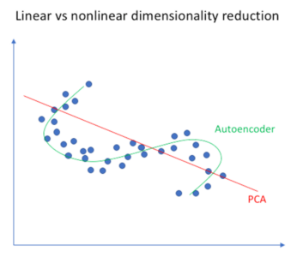
Auto Encoder: Compared to PCA
PCA/SVD
PCA produce smaller set of vectors
Approximate the input vectors via linear combination.
Very efficient for certain applications.
Autoencoder
Can learn nonlinear dependencies
Can use convolutional layers
Can use transfer learning
Used to be called Non-linear PCA
Computer Vision

Slide 8
Layer-wise Pretraining
Computer Vision

Slide 9



Layer-wise Pretraining
Pretraining Layer 1
Train Encoder to reduce the dimension
In a way that it can still be reconstructed back by decoder
Trained using MSE loss against the input
Decoder 1
Encoder 1
-
-
-
-
-
-
-
-
-
-
-
reduced
input
reconstructed
Computer Vision

Slide 10
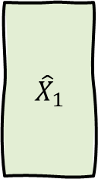

Layer-wise Pretraining
Pretraining Layer 1
After it converges, use the encoder to reduce all data
$$X$$
Encoder 1
-
$${\hat{X}}_{1}$$
-
-
-
-
-
-
reduced
input
Computer Vision

Slide 11
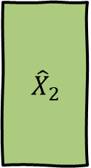
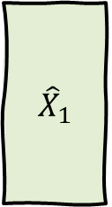
Layer-wise Pretraining
Pretraining Layer 2
Repeat process and use the reduced data to train second encoder to reduce the dimension even further
Repeat for all designed layers
Decoder 2
$${\hat{X}}_{1}$$
-
Encoder 2
-
$${\hat{X}}_{2}$$
-
-
-
-
-
-
reduced 2
input 2
reconstructed 2
Computer Vision

Slide 12


Layer-wise Pretraining
Train Supervised
Stacks all trained encoder layers
Finetune (backprop) the network to classify target
Converge much better and faster
$$X$$
Encoder 1
-
Encoder 2
-
-
$$y$$
-
-
-
output
input
Computer Vision

Slide 13
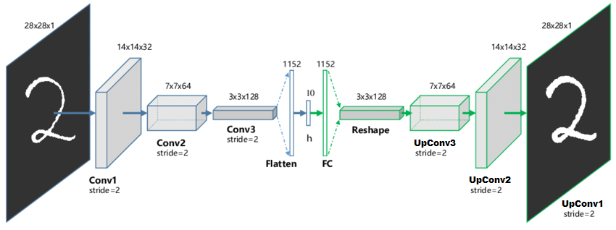
Convolutional AutoEncoder
Computer Vision

Slide 14
Learned Feature Representation
Computer Vision

Slide 15
AutoEncoder Applications
Image Retrieval
Computer Vision

Slide 16
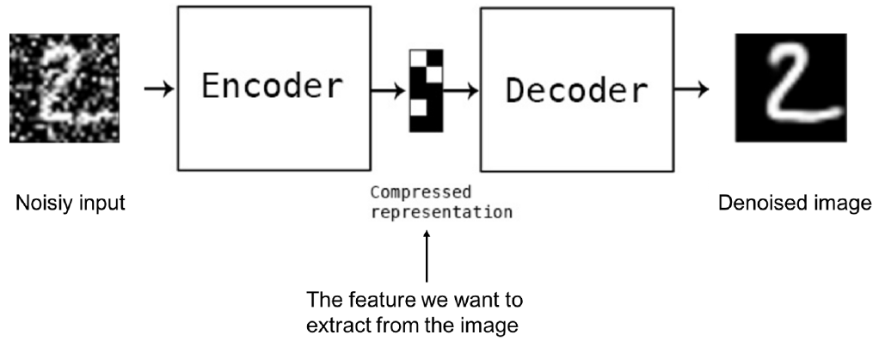
AutoEncoder Applications
Denoising
Computer Vision

Slide 17
AutoEncoder Applications
Image Colorization
Computer Vision

Slide 18
AutoEncoder Applications
Anomaly Detection
Computer Vision

Slide 19
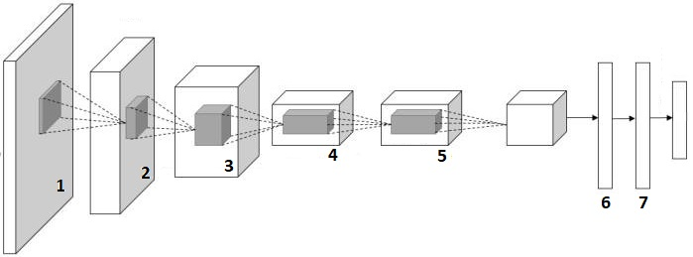
Image Representation
4096-dimensional “code” or “feature vector” for an image (layer immediately before the classifier)
Run the network on many images, collect the feature vectors
fc7 layer
Computer Vision
Notes:
Get the fc7 image → codes of the data

Slide 20
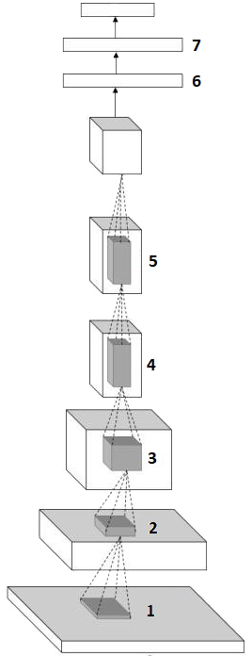
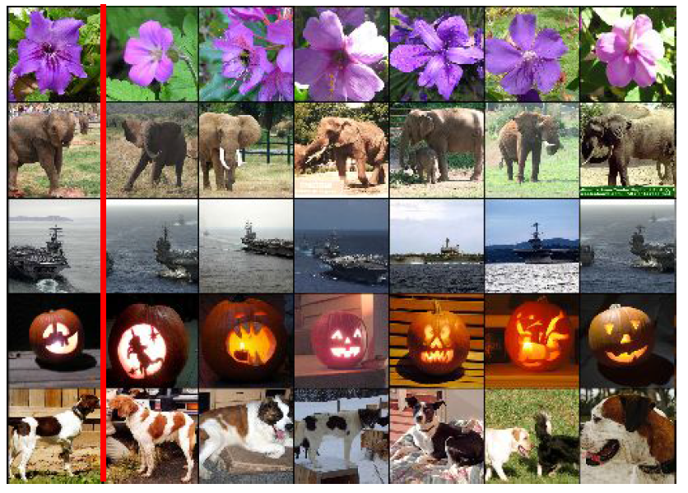
Image Retrieval using CNN
fc7 layer
Computer Vision
Notes:
Get the fc7 image → codes of the data

Slide 21
Transfer Learning
Computer Vision

Slide 22

Transfer Learning
It takes a lot of data to train Deep Neural Net / Convolutional Neural Net
Lots of parameters (weights) must be trained
Too little data will make the network overfit
Computer Vision

Slide 23
Transfer Learning
What if we only have small number of data?
The answer is:
TRANSFER LEARNING
FINE-TUNING
Computer Vision

Slide 24
Transfer Learning
In Practice nowadays, very few people train an entire Convolutional Network from scratch
Use training result from ImageNet
1.2 million images with 1000 categories
Computer Vision

Slide 25
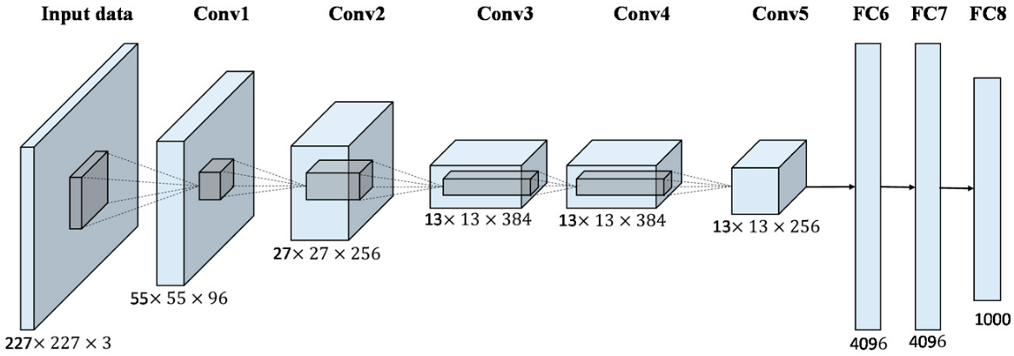
Pre-Trained Weight
We know that Convolution and Pooling layers act as a big feature extraction that feeds the classic Neural Net as a classifier
Feature extraction
Computer Vision

Slide 26
Pre-Trained Weight
Closer to the input, the weights represent more generic features
Dots, colors, edges,
Closer to the softmax output, the weights represent more specific and complex features
Object parts
More generic
More specific
Computer Vision

Slide 27
Transfer Learning
Define the pretrained feature needed according to your case
Things to consider:
How much data do we have
How far is the pattern / type of data from the pretrained model (how far from the ImageNet data pattern)
More generic
More specific
Computer Vision

Slide 28
ConvNet as Feature Extraction
Take the model and weight of the ConvNet network that has been trained with ImageNet
Remove/delete the last softmax and some or even all FC layers
Set the remaining network so that it cannot be trained (freeze)
Install the new "head" (FC layer and softmax) as needed
Train the new network with your dataset
Freeze these
Computer Vision

Slide 29
ConvNet as Feature Extraction
FORWARD PASS
By regulating that some layers cannot be trained, the backward pass will only occur in layers that are not frozen
Just as we only train a few layers of vanilla Artificial Neural Network with ConvNet as a Feature Extraction
BACK
Computer Vision

Slide 30
ConvNet as Feature Extraction
If you have medium-sized data
Or if your data is quite different from ImageNet
Delete or retrain a deeper layer
Or Install a new "head" (FC layer and softmax) somewhere in the middle
Or even train the whole network
Typically, use lower learning rate when finetuning (~1/10 of original LR)
Freeze these
Computer Vision

Slide 31
When and How to fine-tune
Dataset is | Similar to original | Different to original
Small sized | ? | ?
Large sized | ? | ?
You’re in trouble
train the SVM/linear classifier from activations somewhere earlier in the network
train a linear classifier on top of CNN codes (last FC and SoftMax layer)
fine-tune through the entire network
Try other pretrained schemas
more confidence that we won’t overfit, try to fine-tune a few (or all) layers
Computer Vision

Slide 32
Aside: Neural Network
Architecture Visualization
Computer Vision

Slide 33
Neural Net Visualization
Where are the weights? (parameters)
-
-
-
Output layer
Input layer
Hidden
Layer 1
Hidden
layer 2
These are the layers,
Where the weights are attached
Computer Vision

Slide 34
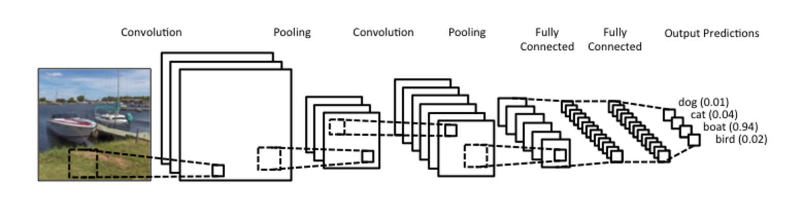
ConvNet Visualization
Where are the weights? (parameters)
These are NOT the layers,
It’s NOT where the weights are
Computer Vision

Slide 35
ConvNet Visualization
These are the actual layers,
It’s where the weights attached
Computer Vision

Slide 36
ConvNet Visualization
These are the output activations
Computer Vision

Slide 37
ConvNet Visualization
Pool layers are actual layers,
But they have no weights
Computer Vision

Slide 38
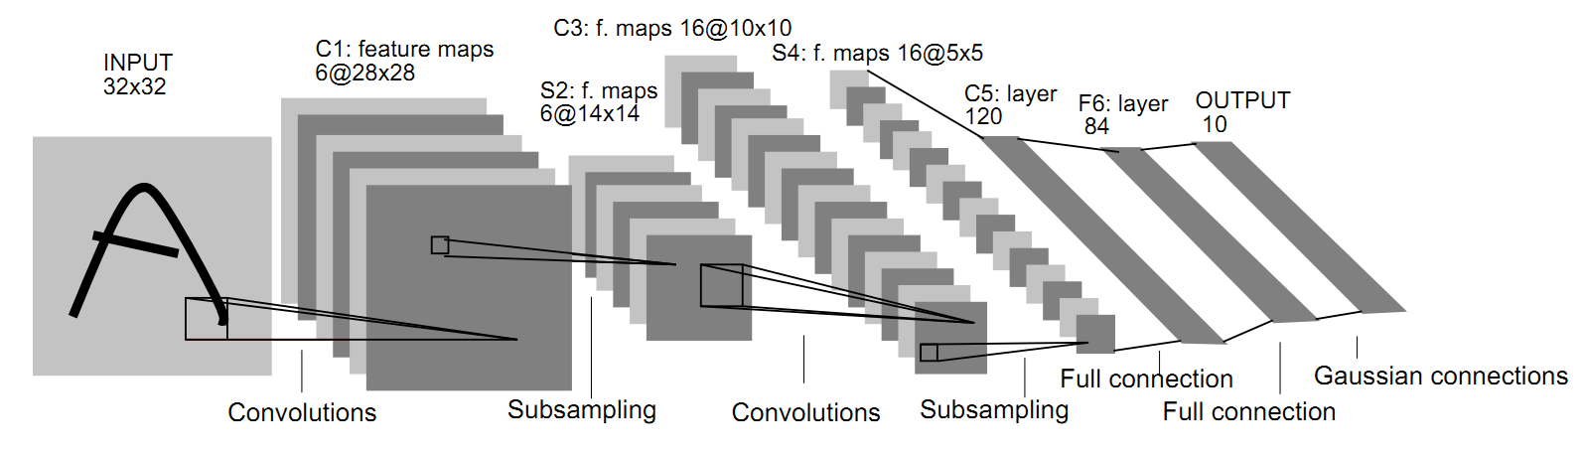
LeNet-5
That’s why it’s called LeNet-5
5
1
2
3
4
[LeCun, Bottou, Bengio, Haffner 1998]
Computer Vision

Slide 39
Aside: Kernel and Sizes
Computer Vision

Slide 40


Convolution Layer
[7x7] image $x$
activation map
[ ? x ? ]
[3x3] filter $W$
7
?
convolve (slide) over all
spatial locations
7
?
3
1
Computer Vision
Notes:
Activation map = the responses of the corresponding filter for all location spatially (at every single spatial position)

Slide 41
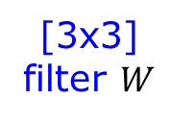
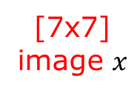


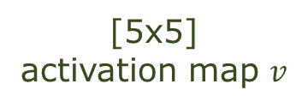
Convolution Layer
[7x7]
image $x$
$$∗$$
[3x3]
filter $W$
$$=$$
[5x5]
activation map $v$
7
7
Computer Vision

Slide 42
Convolution Layer
[7x7] image $x$
activation map
[ ? x ? ]
[3x3] filter $W$
stride = 2
7
?
convolve (slide) over all
spatial locations
7
?
3
1
Computer Vision
Notes:
Activation map = the responses of the corresponding filter for all location spatially (at every single spatial position)

Slide 43
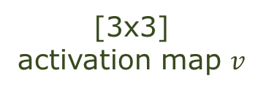

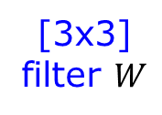
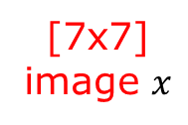
Convolution Layer
[7x7]
image $x$
$$∗$$
[3x3]
filter $W$
$$=$$
[3x3]
activation map $v$
(stride 2)
7
7
Computer Vision

Slide 44
Convolution Layer
[7x7] image $x$
activation map
[ ? x ? ]
[3x3] filter $W$
stride = 1, padding = 1
7
?
convolve (slide) over all
spatial locations
7
?
3
1
Computer Vision
Notes:
Activation map = the responses of the corresponding filter for all location spatially (at every single spatial position)

Slide 45

Convolution Layer
[7x7]
image $x$
$$∗$$
[3x3]
filter $W$
(stride 1)
(padding 1)
[7x7]
activation map $v$
$$=$$
0 | 0 | 0 | 0 | 0 | 0 | 0 | 0 | 0
0 |  |  |  |  |  |  |  | 0
0 |  |  |  |  |  |  |  | 0
0 |  |  |  |  |  |  |  | 0
0 |  |  |  |  |  |  |  | 0
0 |  |  |  |  |  |  |  | 0
0 |  |  |  |  |  |  |  | 0
0 |  |  |  |  |  |  |  | 0
0 | 0 | 0 | 0 | 0 | 0 | 0 | 0 | 0
Computer Vision

Slide 46


Convolution Layer Formula
Input:
w₁ : input width
h₁ : input height
d₁ : input depth
Hyperparameter
K : number of filter
F : filter size (width and height)
S : stride
P : zero padding
Output:
w₂ : output width
h₂ : output height
d₂ : output depth
$w_{2}=\frac{w_{1}−F+2P}{S}+1$
$h_{2}=\frac{h_{1}−F+2P}{S}+1$
$d_{2}=K$
Number of parameters
$\left(F∗F∗d_{1}\right)∗K+K$
Computer Vision

Slide 47
Question?
Computer Vision

